Slide 1



Software Engineering
Lecture 2: Software Engineering Processes / Software Development Lifecycle by Prof. Mohamad Kassab
Leonidas Kontothanassis kthanasi@bu.edu
Notes:
How is this class different from 412? This is more about the principles and theory of SW engineering. 412 is about tooling. In theory this is a prerequisite for 412 but if you are interested primarily in tooling you can see if you can get an exception (not up to me).

Slide 2
Outline
How do we start a software project?
Stakeholders Identifications
Software Process Models
The Waterfall Model
Prototyping Model
Agile Methods
Notes:
Last class, we have established that Software Engineering is not just about the technical process of development, but actually is concerned with all aspects of software production from the early stages of system specification through to maintaining the system after it has gone into use.
and to be able to do that, you need to know what activities are relevant to every aspect and manage their execution.

Slide 3

I. How do we start a software project?

Slide 4

Initiating a Software Project
Starting a software project involves defining the “Business Goal” as a first step.
Star Trek (original):
To explore strange new worlds, to seek out new life forms and new civilizations, to boldly go where no one has gone before.
Baggage Handling System:
To automate all aspects of baggage handling from passenger origin to destination.

Slide 5
Business Goals
Organizations have a reason for needing the proposed system
This could be characterized in a number of different ways
Market intent
Product roadmap
Business & operational strategy
…
Ideally this would describe high level goals, associated measures, and tactical approaches

Slide 6
Types of Organizations
There are several types of organizations
We’ll look at a couple of examples here:
1. Those that generate revenue directly from the construction, sale or licensing of software intensive products.
2. Those that generate revenue from non-software sales and services but rely on software for operations.

Slide 7
A Taxonomy of Companies with respect to SW
Traditional Software Companies
Software as a Service (SaaS) Providers
Open Source–Driven Organizations
Platform and Ecosystem Builders
Hardware-Centric Firms with Software Integration
Consulting and Professional Services Firms
Hybrid “Product + Service” Companies
Nonprofit and Public Sector Organizations
Internal-Use-Only Software Creators
Notes:
0. Traditional software companies (increasingly rare). Oracle? Microsoft?
1. Software as a Service (SaaS) Providers Revenue comes from subscription or usage fees for hosted software. Examples: Salesforce, Slack, Zoom. 2. Open Source–Driven Organizations Software itself may be free, but revenue comes from. Support and consulting services (e.g., Red Hat). Freemium/Premium models 3. Platform and Ecosystem Builders Core revenue is from transactions or services enabled by the platform. AppStores/Ads/{aypal
4. Hardware-Centric Firms with Software Integration Hardware sales drive revenue, but the value proposition is increasingly tied to software. Tesla? Apple
Examples: Tesla (cars + software updates), Apple (iPhone + iOS), Nintendo (consoles + games).
5. Consulting and Professional Services Firms Software is not the product, but revenue comes from custom development/integration. Accenture/IBM?
6. Hybrid “Product + Service” Companies Sell a physical or digital product but also rely on recurring service revenue enabled by software. Peloton.
7. Nonprofit and Public Sector Organizations Not profit-driven, but rely on software for mission delivery. NGOs of various kinds.
8. Internal-Use-Only Software Creators Large organizations (banks, insurance, logistics firms) that build sophisticated in-house software.

Slide 8
SOFTWARE Oriented Companies
If the organizations is in the business of developing software they will often have some kind of product roadmap
This roadmap typically includes things like:
Market related information
Value proposition for the market
Competitive analysis
Anticipated number of units
Target price
Anticipated revenue
Associated budgets
…

Slide 9
Non-Software Companies
These organizations often have strategic plans.
These plans are focused on their domain and not specifically on software.
You can be sure, however, that the objectives reflected in the plan rely on software.
Even if no one realizes that’s the case
Consider Walmart

Slide 10
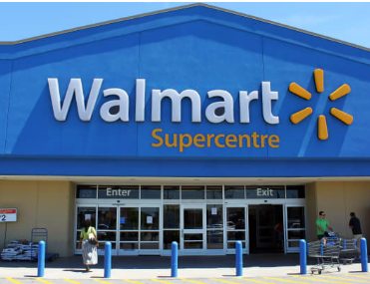
Walmart and Data
Walmart collects data on every transaction that every customer makes in every store
This is roughly 267 million transactions a day
They are forever trying to improve their understanding of buying characteristics
This knowledge can influence
Promotions
Inventory
Supply chain process
Store layout
…
One of the largest tech employers in the country with 20K+ tech employees.

Slide 11

Case study: Building Automation System
Consider a company that primarily sells hardware devices for building automation.
They have software applications that manage a network of these devices but this constitutes a loss leader, i.e. they lose money on the software but it helps the sale of the hardware devices.
The company realizes that the hardware is being commoditized and over time the profit margins on the sale of their hardware devices are going to shrink. In order to sustain their business long term, the company decides to create a new building automation system that will be profitable.

Slide 12

Case study: Building Automation System
They wish to accomplish this by doing two things
reduce internal development costs and expand the market.
Internal development costs can be reduced by replacing several of the existing applications with a single building automation system.
Market expansion can be achieved by entering new and emerging geographic markets and opening new sales channel in the form of Value Added Resellers (VARs). VARs sell the new building automation system under their own brand to support building automation hardware devices of many different manufacturers.

Slide 13
Case study: Building Automation System
Business goals for Building Automation System:
Reduce internal development costs
Expand by entering new and emerging geographic markets
Open new sales channels in the form of value added resellers (VARs)
Support 3rd party devices

Slide 14

ii. Stakeholders identification

Slide 15
Requirements Stakeholders
Who are they?
What do they want?
What don’t they want?
Do they really know what they want?
Why do they change their minds?
How can you uncover and mitigate these issues?

Slide 16

Who is a Stakeholder?
A customer (or client or user)?
The customer is always right, but there are more persons/entities with an interest in the system.
We use “stakeholder” to remember that others, not just the customer are involved.

Slide 17
Typical Stakeholders
Customers (clients, users)
Sponsors (those who have commissioned and/or will pay for the system)
All responsible engineering and technical persons (e.g. systems, development, test, maintenance)
Regulators (typically, government agencies at various levels)
Third parties that have an interest in the system but no direct regulatory authority (e.g. standards organizations, users groups)
Society (is the system safe?)
Environment (for physical systems)
Professors (e.g. for this course)
This is an incomplete list

Slide 18
Negative Stakeholders
Typical Stakeholders (Continue)
Those who “lose” if system is built
Competitors
Activists
Enemies
Gadflies/
Contrarians

Slide 19
Identifying Stakeholders: Ask these questions
Stakeholders Identification Questionnaires (To assist in identifying stakeholders)
Who is paying for the system?
Who is going to use the system?
Who is going to judge the fitness of the system for use?
What agencies (government) and entities (non-government) regulate any aspect of the system?
What laws govern the construction, deployment and operation of the system?
Who is involved in any aspect of the specification, design, construction, testing, maintenance, and retirement of the system?
Who will be negatively affected if the system is built?
Who else cares if this system exists or doesn’t exist?
Who have we left out?

Slide 20
Exemplar System
Airline baggage handling
Embedded, real-time
Moves baggage from a central loading point and redirects to one of many conveyors based on bag id
Denver International Airport tried a such a system
System used PCs, thousands of remote-controlled carts, 21-mile-long track
Carts move along the track, carrying luggage from check-in counters to sorting areas and then straight to the flights waiting at airport gates.
Each piece of baggage has a special bar-coded tag
After spending $230 million over 10 years, project was cancelled*
https://www5.in.tum.de/~huckle/DIABaggage.pdf

Slide 21
Airline Baggage Handling System
Who is paying for the system? – Airline, grants, passengers, tax dollars?
Who is going to use the system? – Airline personnel, maintenance personnel, travelers (at the end). Who else?
Who is going to judge the fitness of the system for use? – Airline, customers, unions, FAA,OSHA, the press, independent rating agencies. Who else?
What agencies (government) and entities (non-government) regulate any aspect of the system? – FAA, OSHA, union contracts, State and local codes. What else?
What laws govern the construction, deployment and operation of the system? – Various state and local building codes, federal regulations for baggage handling systems, OSHA laws? What else?
Who is involved in any aspect of the specification, design, construction, testing, maintenance, and retirement of the system? – various engineers, technicians, baggage handlers union, etc. We need to know them all.
Who will be negatively affected if the system is built? – passengers? Union personnel? Who else?
Who else cares if this system exists or doesn’t exist? – limousine drivers? Who else?
Who have we left out?

Slide 22

Stakeholder Prioritization
Not all stakeholders are of equal importance.
Stakeholder needs and desires may conflict.
Ranking/prioritization helps in resolving these conflicts.
Usually rank denotes risk of not satisfying the stakeholder (e.g. legal requirements should be #1 unless you want to go to jail)
Requirements prioritization is the key to reconciliation and risk mitigation -- so get used to it!

Slide 23
Partial Ranking for Baggage Handling System

Slide 24
III. Software Process Models

Slide 25
The Big Problem
Business Goals
How to bridge the gap between Business Goals and solutions?
???
Solution

Slide 26
One Possible Answer
Business Goals
Ad hoc
Requires gurus
Unpredictable
Costly
A Miracle Happens!
Implementations

Slide 27
Business Goals
In software engineering, a software development process, also known as the Software Development Life Cycle (SDLC), includes several phases that provide a method for building software products that meet technical specifications and user requirements.
Software development process
Implementations

Slide 28

Process models
There are different process models. Let’s explore some of these:
The Waterfall Model
Prototyping Model
Agile Method
Notes:
The process flow schemes are the basis for the different process models out there.
We are going to discuss some of the main process models in the field of software engineering

Slide 29
The waterfall model

Slide 30
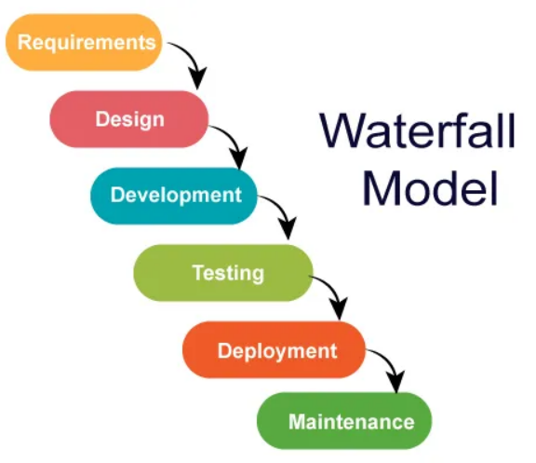
The Waterfall model is the oldest paradigm in software engineering.
Still widely used, especially by organizations like the US Department of Defense and NASA.
Emphasizes spending time early on to ensure the accuracy of requirements and design.
Divides the project into distinct phases.
Order of Phases: Requirements → Design → Implementation → Testing → Maintenance.

Slide 31
APPLICABILITY OF WATERFALL MODEL
Ideal for well-defined adaptations or enhancements to an existing system.
Suitable for new development efforts when requirements are well defined and stable.
Commonly used in government projects, large-scale systems with defined specifications.
NASA and DoD: Noteworthy examples of organizations utilizing the Waterfall model.

Slide 32
CHALLENGES WITH WATERFALL MODEL
Inflexibility: Does not accommodate changes well after the project has started.
Late Testing: Testing occurs late in the process, raising the risk of identifying issues at a later stage.
Delayed Work Products: Deliverables are not available until late in the project timeline.

Slide 33
PROTOTYPING model

Slide 34
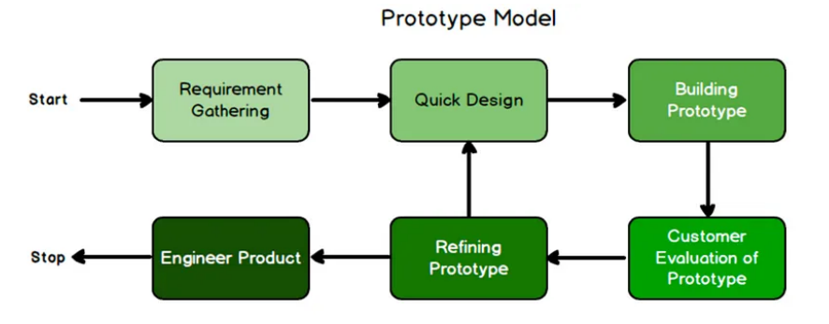
Prototyping Model
Prototyping assists you and the customer to better understand what is to be built when requirements are fuzzy.
When a customer just defines a set of general objectives for the software.
A minimum viable product (MVP) can then be produced.
Notes:
but does not identify detailed requirements for functions and features
A minimum viable product (MVP) is a version of a product with just enough features to be usable by early customers who can then provide feedback for future product development.

Slide 35
Types of prototyping
Throwaway/Rapid Prototyping:
Quickly built and discarded after obtaining feedback.
Evolutionary Prototyping:
Incremental development, refining the prototype based on user feedback.

Slide 36
Advantages of prototyping
User Involvement: Encourages active participation and feedback from end-users.
Early Detection of Issues: Identifies problems and changes early in the development process.
Flexible Changes: Allows for changes in requirements during development.

Slide 37
Challenges of prototyping
Time-Consuming: Iterative nature may extend development time.
Incomplete Functionality: Early prototypes might lack full functionality.
Miscommunication: Potential for misunderstandings between developers and users.

Slide 38
PROTOTYPING : REAL WORLD EXAMPLES AND TOOLS
Mobile App Development: Prototyping is commonly used for mobile applications to refine user interfaces.
Web Development: Rapid prototyping is effective for user experience testing in web development.
Balsamiq, Axure, Sketch: Popular tools for creating wireframes and interactive prototypes.
Figma: Collaboration platforms for sharing and testing prototypes.

Slide 39
EXERCISE (optional)
Objective: Create a wireframe prototype for a weather application screen using Balsamiq.
Scenario: Design a user-friendly interface providing current weather information, short-term forecast, and city selection.
Watch video: https://www.youtube.com/watch?v=E5Z1QOly72E

Slide 40
AGILE MODELS

Slide 41
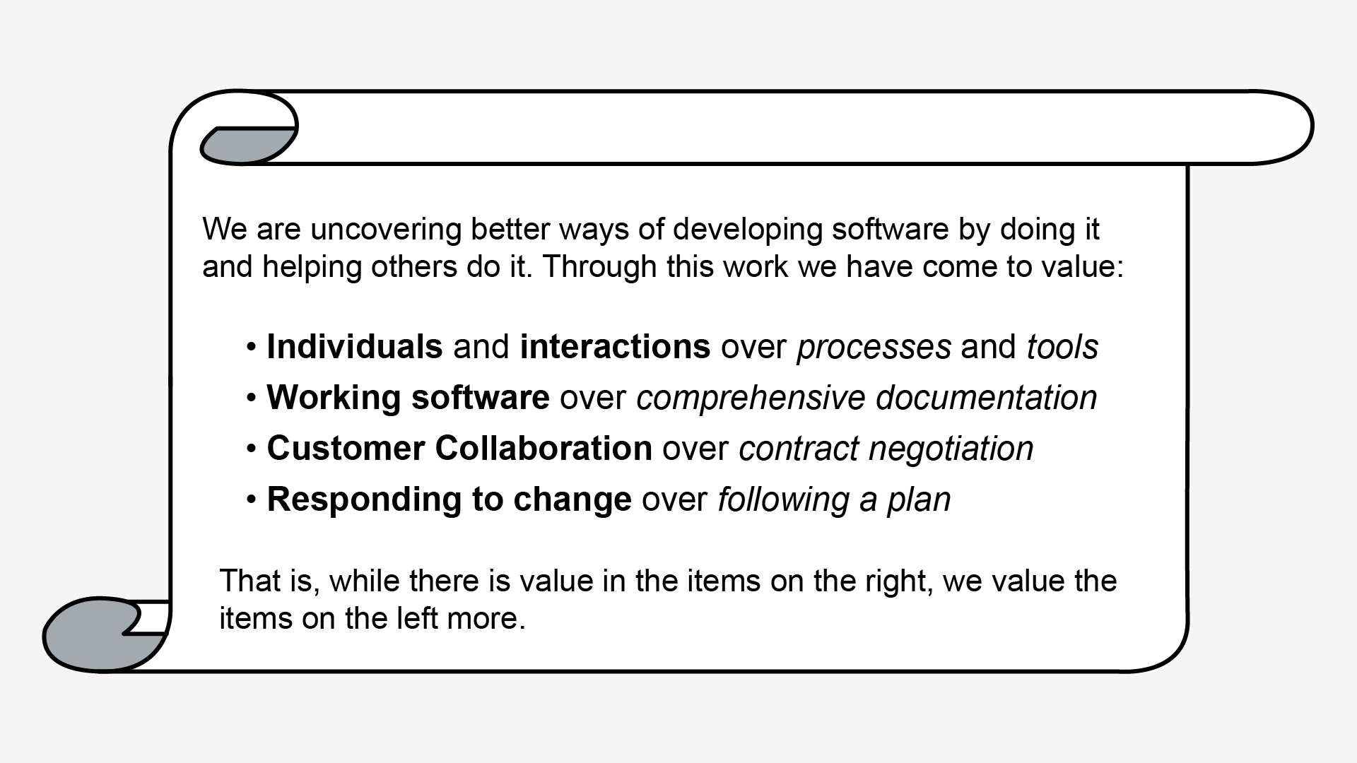
Agile Process model
In 2001, the “Agile Alliance” signed the Agile Manifesto. It stated the main values for Agile Development
Notes:
The Agile Manifesto was written in 2001 by a group of independent-minded software engineers.
What does each statement entail?
When you allow each person to contribute uniquely to your software development project, the result can be powerful. Teamwork becomes strong as people learn how to work together.
Remember, all projects require some documentation. In agile projects, documents are useful only if they’re sufficient enough for the development of a working product in the most direct way. Often, the only documentation needs are Requirements documentation and Product technical specifications: Documenting how you created a product can make future changes easier, as the team’s focus should be on producing working products.
Agile processes make the customer part of the project on an ongoing basis. customer review is built into the process.
Project teams that can respond quickly to customers and the market are able to develop relevant, helpful products that people want to use. The flexibility of agile approaches actually increases project stability, because change on agile projects is predictable and manageable.

Slide 42

Agile Principles
Our highest priority is to satisfy the customer through early and continuous delivery of valuable software.
Welcome changing requirements, even late in development. Agile processes harness change for the customer's competitive advantage.
Deliver working software frequently, from a couple of weeks to a couple of months, with a preference to the shorter timescale.
Business people and developers must work together daily throughout the project.
Build projects around motivated individuals. Give them the environment and support they need, and trust them to get the job done.

Slide 43
Agile principles
6. The most efficient and effective method of conveying information to and within a development team is face-to-face conversation.
7. Working software is the primary measure of progress
8. Agile processes promote sustainable development. The sponsors, developers, and users should be able to maintain a constant pace indefinitely.
9. Continuous attention to technical excellence and good design enhances agility.
10. Simplicity--the art of maximizing the amount of work not done--is essential. “Do the simplest thing that could possibly work.”
11. The best architectures, requirements, and designs emerge from self-organizing teams.
12. At regular intervals, the team reflects on how to become more effective, then tunes and adjusts its behavior accordingly.

Slide 44
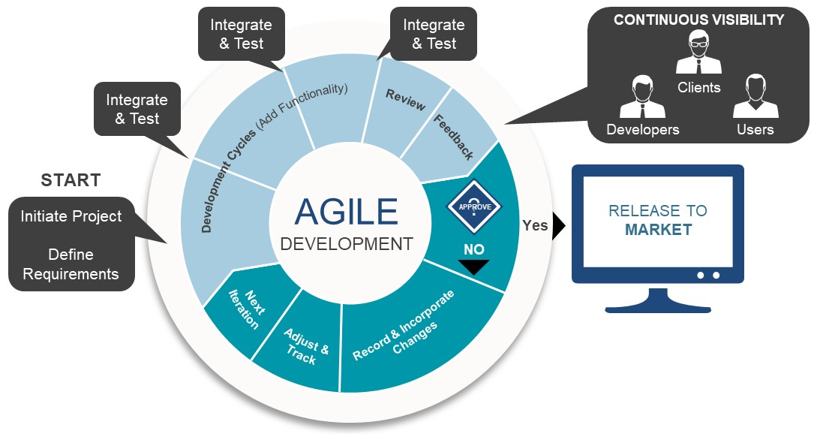
Examples of agile models
Extreme Programming (XP)
Scrum
Kanban
Crystal
DSDM
FDD
Lean
Notes:
Agile divides work into several stages while ensuring continuous collaboration with customers.
At each phase, constant monitoring is a must. Both the developing and testing activities are parallel and synchronized in the agile methodology.
There are 7 Different Types Of Agile Methodologies
Scrum, Kanban → Most widely used; differ in structure (time-boxed vs continuous flow).
XP → Engineering excellence practices. Focus more on how to deliver code vs scrum which focuses on organizing work/sprints.
Crystal → People over processes, adaptable to team size.
DSDM → Enterprise/business-focused structured Agile. Must Have, Should have, Could Have, Won’t Have.
FDD → Feature-driven, model-first, suited for large projects. More nimble than DSDM, priorities can change more easily.
Lean → Principles-driven, efficiency-focused. Eliminate waste, reduce cost, flexibility.

Slide 45
Scrum
Scrum relies on a process pattern called a sprint.
Sprint: A time-boxed iteration during which a potentially shippable product increment is created. Sprints are usually 2 to 4 weeks long and provide a consistent rhythm to the development process.
The number of sprints required will vary depending on product complexity and size
Notes:
Sprints—consist of work units that are required to conduct the activity
Time-box: a period of time that has been allocated to accomplish some task

Slide 46
Scrum team
Product Owner:
The person responsible for defining the features and functionalities of the product, prioritizing the product backlog, and ensuring that the team delivers value to the customer.
Scrum Master:
The individual responsible for facilitating the Scrum process, removing impediments, and ensuring that the team follows Scrum practices. The Scrum Master acts as a servant-leader for the team.
Development Team:
A self-organizing, cross-functional group of individuals responsible for delivering the product incrementally. The team works collaboratively to achieve the goals set for each sprint. The team will include developers, software testers, software architects.

Slide 47
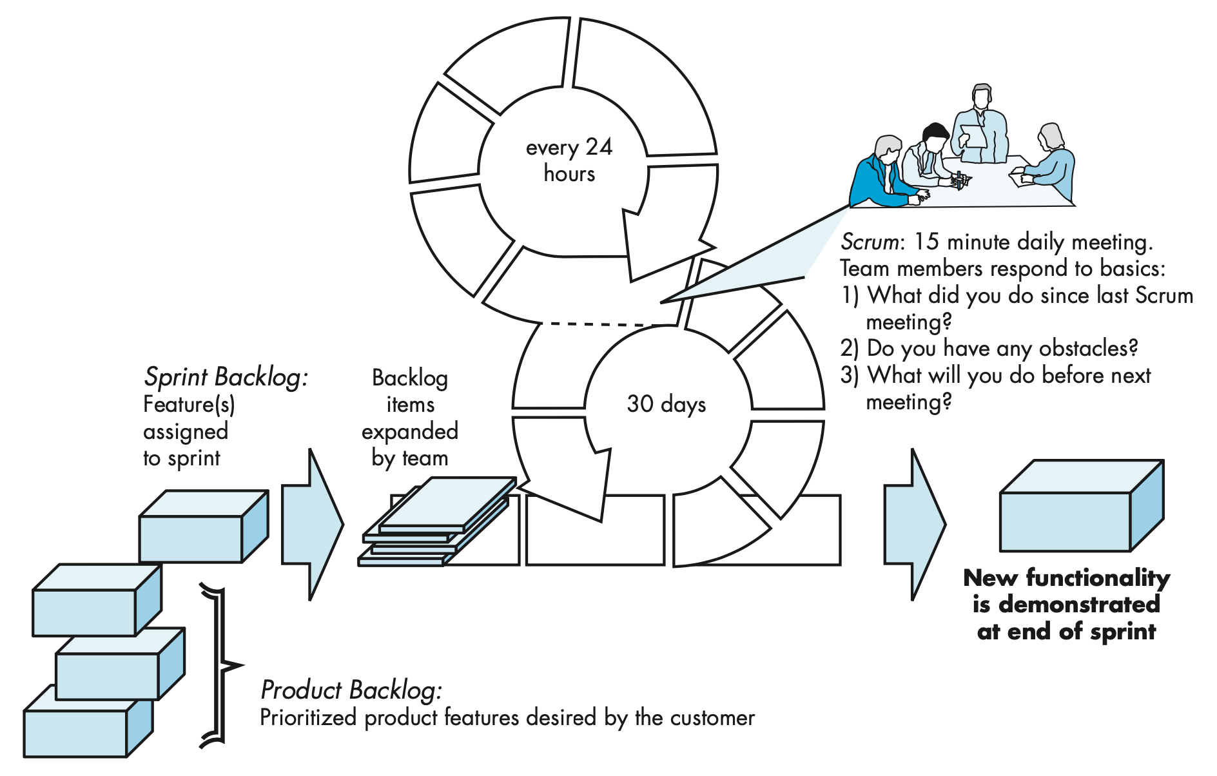
Scrum workflow
Scrum master
Notes:
so this is an illustration of the scrum workflow, which starts with planning

Slide 48

Scrum workflow
Scrum master
Notes:
Planning: (as part of planning ..)
The development team works with the product owner and all other stakeholders to develop the items in the product backlog.
Both the product owner and the development team rank the items in the product backlog by the importance of the business needs and the complexity of programming and testing required to complete each of them.
The development team determines what can be delivered in the increment given the constraints of the time-box allocated for the sprint and, with the Scrum master, what tasks will be needed to deliver the increment.
Product backlog
Prioritized list of all the product requirements or features that provide business value for the customer.
similar to in XP, agreed upon Items can be added to the backlog at any time
Sprint Backlog:
A subset of product backlog items selected by the product team to be completed in the current sprint.
No new features can be added to the sprint backlog unless the sprint is cancelled and restarted.
this allows the team to work in a short-term, stable environment.

Slide 49
PRODUCT VS. SPRINT BACKLOG
Product backlog
Prioritized list of all the product requirements or features that provide business value for the customer.
Agreed upon items can be added to the backlog at any time
Sprint Backlog:
A subset of product backlog items selected by the development team to be completed in the current sprint.
No new features can be added to the sprint backlog unless the sprint is cancelled and restarted.

Slide 50
Scrum workflow
Scrum master
Notes:
Sprint:
The development team creates a plan for delivering a software increment
Most sprints are time-boxed to be completed in 2 to 4 weeks.
How the development team completes the increment is left up to the team to decide.
The team meets daily, as a way to track progress
The development team also decides when the increment is done and ready to demonstrate to the product owner.
The product owner decides whether to terminate a sprint or extend the sprint if the increment is not accepted.
The increment is the union of all backlog items completed in previous sprints and all backlog items to be completed in the current sprint.
15 minutes Daily Meeting:
To make plans for the next 24 hours
Track progress
declare sprint backlog items complete or done
Please tell me how can the meeting help the team and in what ways?
Remember, these are not problem-solving meetings, those occur off-line and only involve the affected parties
Why meetings?
The Scrum meeting helps the team to uncover potential problems as early as possible.
promotes a self-organizing team structure
When the team considers all sprint backlog items complete, the team may decide to schedule a demo and review of the completed increment with the product owner.

Slide 51
Scrum workflow
Scrum master
Sprint Review Meeting
Sprint Retrospective Meeting
Notes:
When the team considers all sprint backlog items complete, the team may decide to schedule a demo and review of the completed increment with the product owner.
Sprint Review Meeting:
The sprint review is often a 4-hour meeting
Everyone attends this meeting (The Scrum master, the development team, the product owner, and selected stakeholders).
The main activity is a demo of the software increment completed during the current sprint.
The product owner decides if the increment is accepted or not.
If not accepted, the product owner and the stakeholders provide feedback to allow a new round of sprint planning to take place.
This is the time when new features may be added or removed from the product backlog.
Sprint Retrospective Meeting:
(before beginning another sprint planning meeting)
Scrum master will schedule a 3-hour meeting (for a 4-week sprint) with the development team
Reflect on the performance in the previous sprint
What went well in the sprint
What could be improved
What needs to be done to improve the quality in the next sprint

Slide 52
meetings in scrum
Sprint Planning: A meeting at the beginning of each sprint where the team, Product Owner, and Scrum Master collaborate to define the goals for the sprint and select the items from the product backlog to be worked on.
Daily Standup (Daily Scrum): A short, daily meeting where team members discuss their progress, plans for the day, and any impediments they are facing. It helps in keeping everyone informed and the team synchronized.
Sprint Review: Demoing and deciding if a sprint’s output will be accepted or reject. Feeds into next planning meeting.
Sprint Retrospective: A meeting at the end of each sprint where the team reflects on its own processes and identifies opportunities for improvement. It helps in continuous learning and adaptation. It answers questions:
What went well and what went wrong in the sprint
What could be improved
What needs to be done to improve the quality in the next sprint

Slide 53
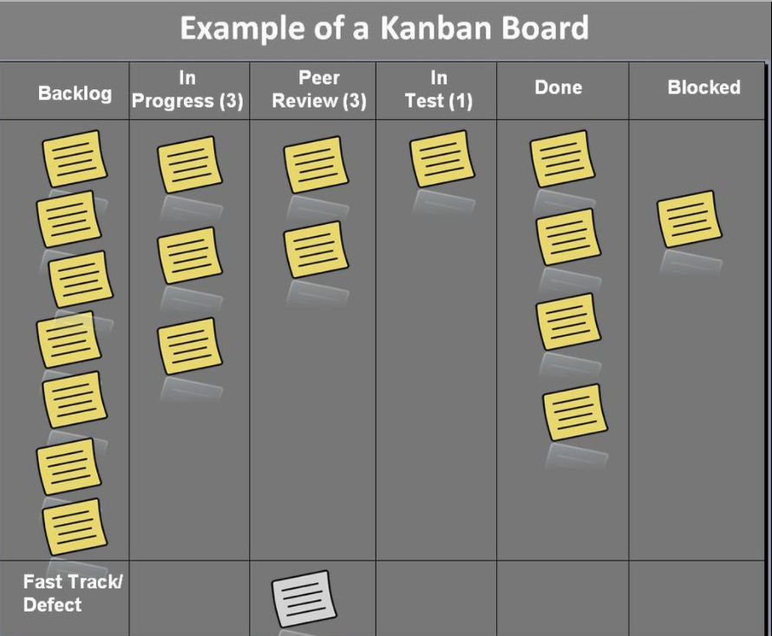

Slide 54
AGILE VS RAPID PROTOTYPING
Aspect | Rapid Prototyping | Agile Development
Purpose | Explore ideas and validate concepts | Build real, evolving software
Output | Mockups or prototypes (throwaway or partial) | Production-ready increments
Focus | Design/requirements clarification | Full lifecycle: requirements, code, testing, delivery
When Used | Early in the project, before major development | Throughout the entire project
Iteration Speed | Very quick (hours–days) | Short cycles (1–4 weeks)

Slide 55


Readings , Assignments, Project Tasks
Read:
Chapters 2 and 3 of the textbook.
Assignments & Project Tasks:
The project is open. Start forming the teams and work on Project Deliverable 1.

Slide 56

Questions?

